Slide 1
Headline News Application
By Bianyu Wang
Yangyang Ma
May 13, 2019

Slide 2
Background
An application that can display the user’s favorite channels’ news
User can subscribe up to five channels, he can change his choices
Administrator can manage channels: add/update/delete channel

Slide 3
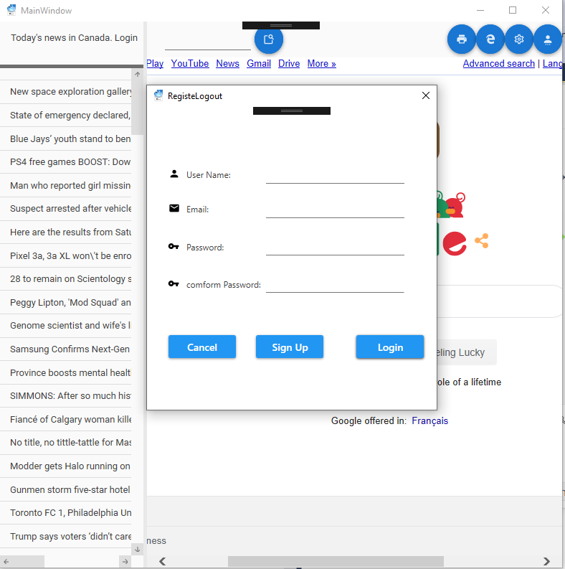
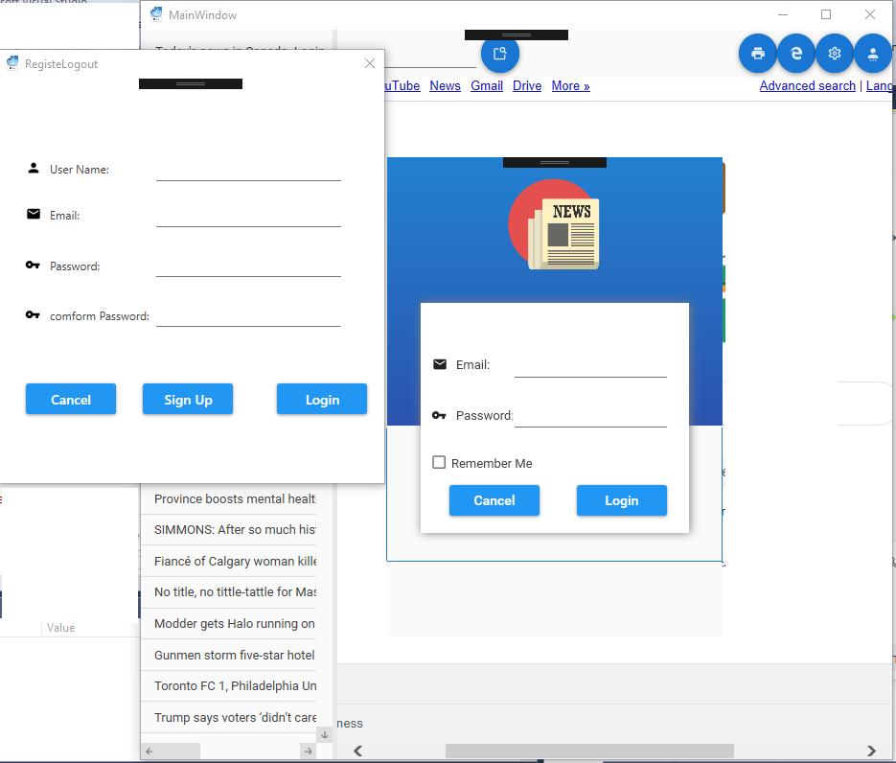
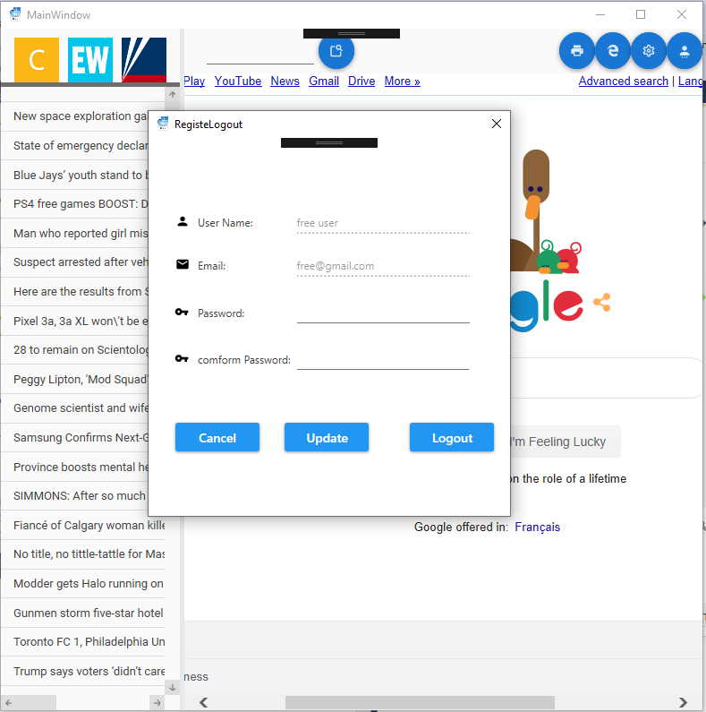
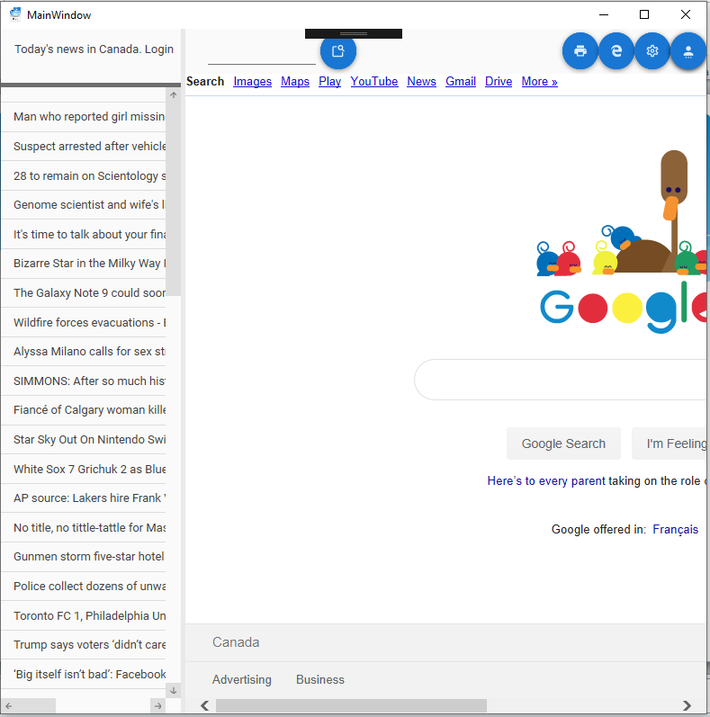
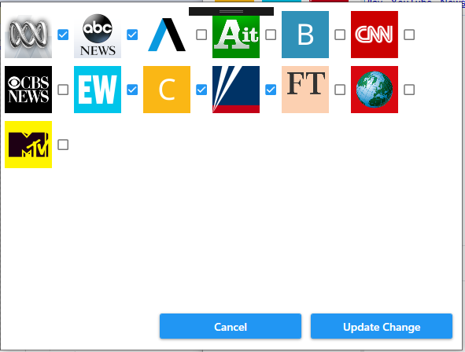
Solution overview – two interfaces - Client

Slide 4
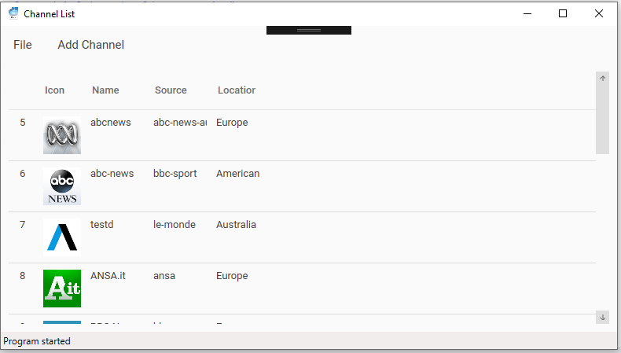
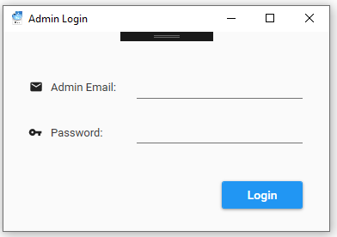
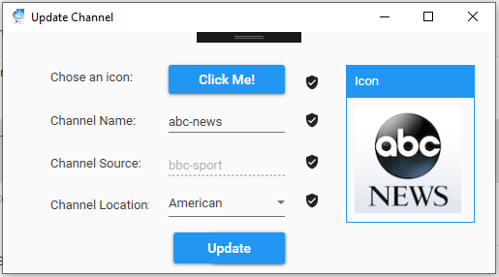
Solution overview – two interfaces - Admin

Slide 5
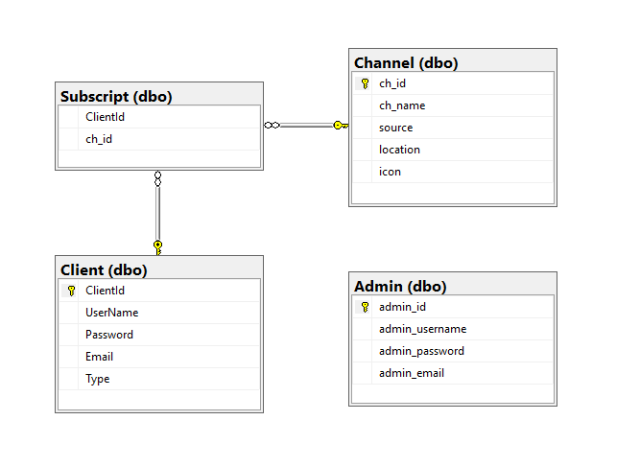
Database Structure

Slide 6


Technologies or Solution to the Problems
Installer
Material Design
Add icon to title bar
Printing：print IE area in to pdf or with printer
Open IE browser

Slide 7
Technologies or Challenges and Solutions
System Configuration Management : Remember me
MD5 ：Password encryption
Wrap panel, GridSplitter…..
Delegate: add children elements and event handler
Silence javascript errors.
Fetch From API: Newtonsoft.Json (framework)
Blob: image -> Database(varbinray)

Slide 8
What We learned
System. Configuration
Blob
MD5
Fetch From API
Add element and event handler dynamically

Slide 9
Future Work
Add advertisement table and ads bar in the window
Distinguish client as paid or unpaid, if they paid, there will be no ads displayed
Add super admin to manage admins
Improve the layout and UI

Slide 10
Summary
All about how to handle the event and which event should be handled!!!

Slide 11


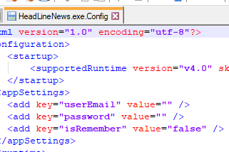
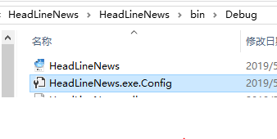
What We Learned
Use System. Configuration to “Remember me”
1. where ? add <appSetting> into App.config
2. how do we know it works…

Slide 12
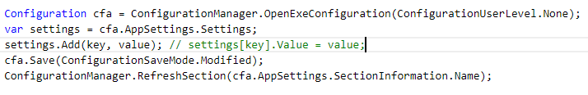
What We Learned
Use System. Configuration to “Remember me”
3. Read setting
3. Write setting

Slide 13
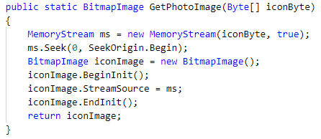
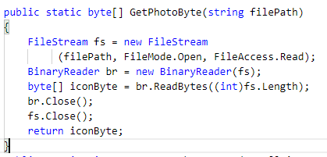
What We Learned (Blob)
Need a image of database
Basic: image -> byte[] ⬄ byte[] -> image

Slide 14
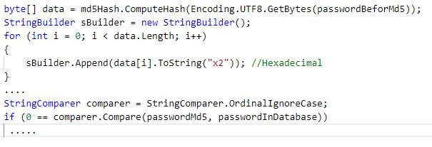
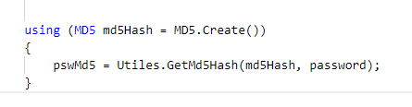
What We Learned(MD5)
MD5

Slide 15

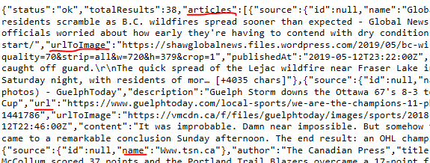
What We Learned(API)
USE FRAMEWORK
Test API:
Get Json object

Slide 16
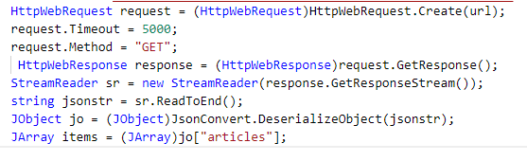
What We Learned(API)
Get Json object and convert it to String

Slide 17
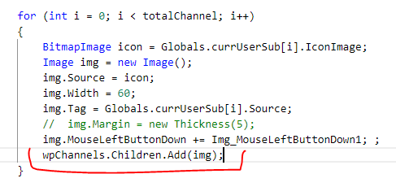
What We Learned(add element)

